Slide 1
Asynchronous JavaScript
JavaScript

Slide 2
What is Asynchronous Code?
In programming there is code that must execute precisely in an order—one line after another. This is referred to synchronous code. Most—if not all—of what we’ve covered by this point would follow under this umbrella.
The alternative to synchronous, is asynchronous. Asynchronous code may run alongside (at the same time as) the rest of your code. It opens doors for us to have time-consuming requests run in the background while the user can maintain basic functionality within your program or webpage.
There are numerous features in JavaScript that are considered asynchronous in nature; in the following slides we’ll cover a few…
Callbacks
Timeouts
Intervals
Promises
Async/Await

Slide 3
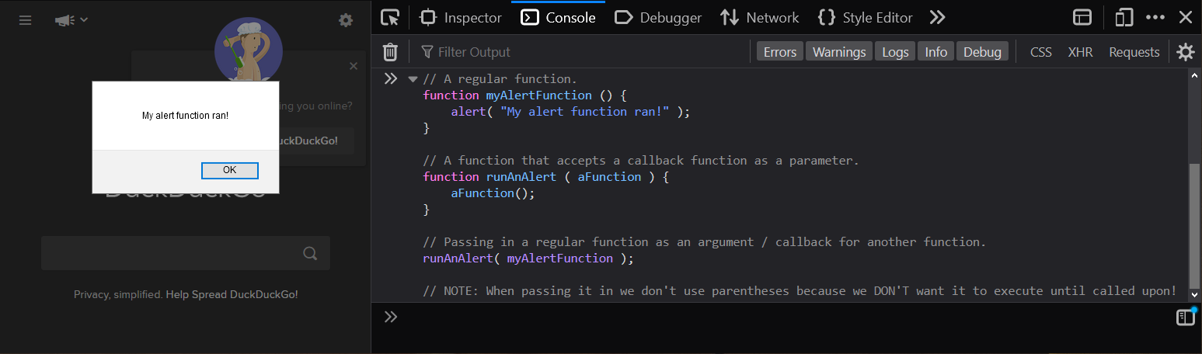
Callbacks
The term callback, in JavaScript programming, refers to the practice of passing a function as an argument into another function.
Via this feature you can later execute the passed-in function as many times as needed.
When passing a function as an argument, ensure you exclude parentheses. This is because we don’t want the function to execute while we pass it in, we just want to pass in the function itself.
The parentheses tell JavaScript it should execute immediately.
Functions can be passed into functions!

Slide 4
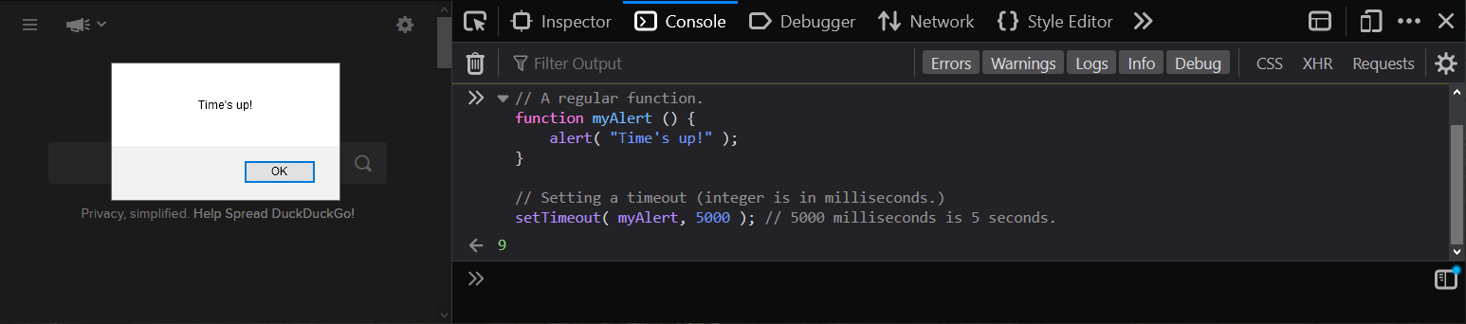
Timeouts
We can use the setTimeout function built into JavaScript to have our code wait a specified number of milliseconds before execution of a function of our choosing.
Note that 1000 milliseconds is equal to 1 second.
A timeout only runs a single time; if you need something to occur over and over, consider an interval instead.
If you want JavaScript to wait until some time has passed before executing a function, use a timeout.

Slide 5
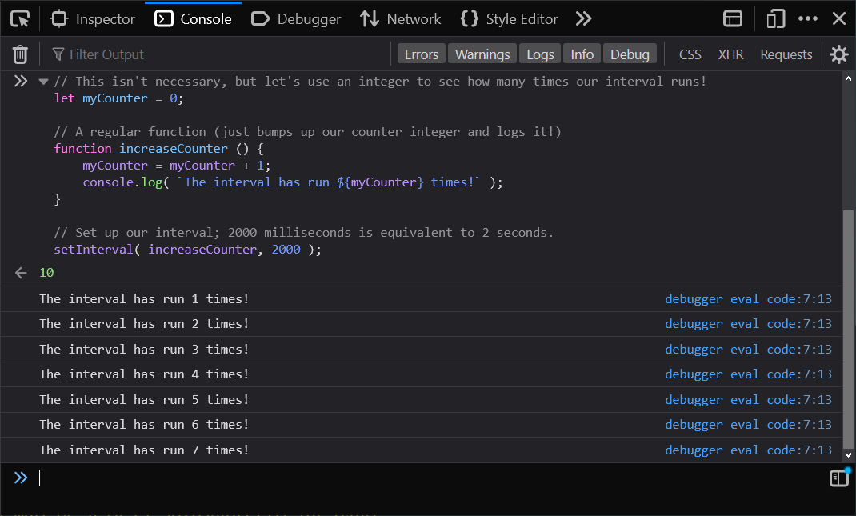
Intervals
Much like a timeout, JavaScript will wait the specified amount of time before executing the function you passed in when using setInterval.
Where it differs, is that it will continue to run again and again each time that specified time period passes!
If you’d like to repeat a set of instructions again and again after a set number of milliseconds, set up an interval.
Notes:
How many times will this run?

Slide 6
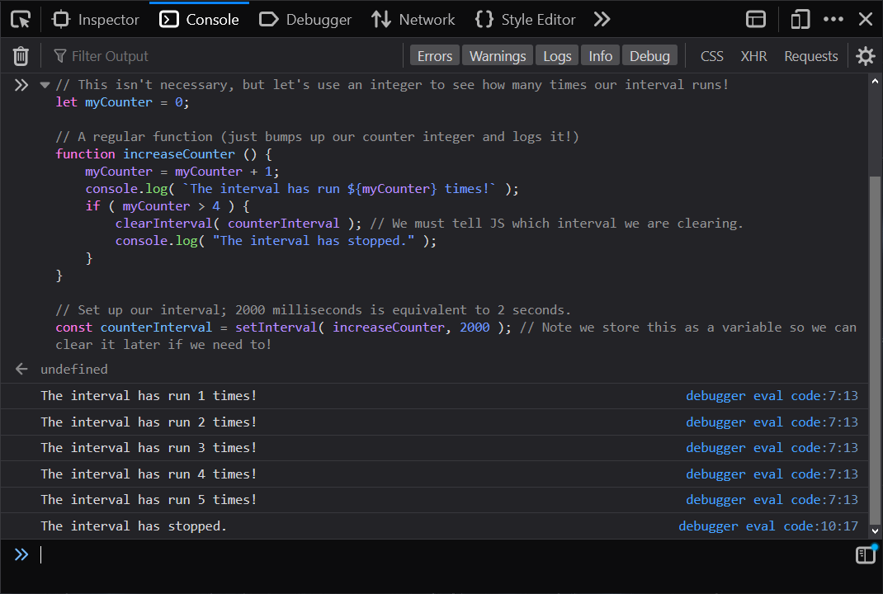
Clearing an Interval
To stop an interval, JavaScript affords us the clearInterval function.
Pass in the name representing your interval, and it will not run that interval function again (unless you begin it again elsewhere in your program.)
What if we don’t want our interval to repeat forever!? You’re in luck!
Notes:
Store any interval you set in a variable, so you can easily clear it later if/as needed.

Slide 7
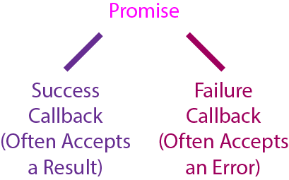
Promises
A promise in JavaScript represents a success or failure for an asynchronous set of instructions.
There are a few syntaxes available for working with promises in modern JavaScript, so it is good to familiarize yourself with how these look so that you can easily recognize them and refresh your your memory with an appropriate article when coming across one.
Modern functions by default return a promise that you can attach callbacks to.
When a function runs, you can add a “.then” method afterward to handle your success or failure case.
A return will be counted as a success, a throw will be counted as a failure.
yourFunction().then( successCallback, failCallback )

Slide 8
Async and Await
An alternative to promises to invoke asynchronous code would be use of the async and await keywords with your functions.
If you precede a function declaration with the async keyword, it will return a promise. This allows it to be run asynchronously.
Inside of an async function, you are able to utilize the await keyword—the function instructions only continue once the promise beside the await resolves.
Both promises and async/await are most often used in cases where time-consuming tasks must be handled “in the background” so that a user can continue using features or your webpage properly in the meantime.
We’ll get to see these in action once we start working with JavaScript’s fetch API, as it can be resource and time intensive to load data from files or other websites in your webpage.

